Slide 1
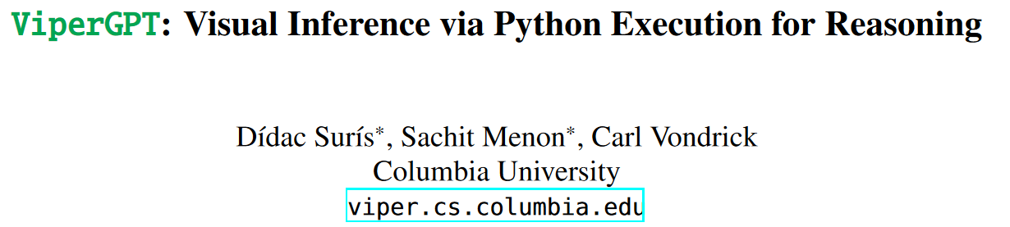
Reporter: Lu Zhen 2024/04/12

Slide 2
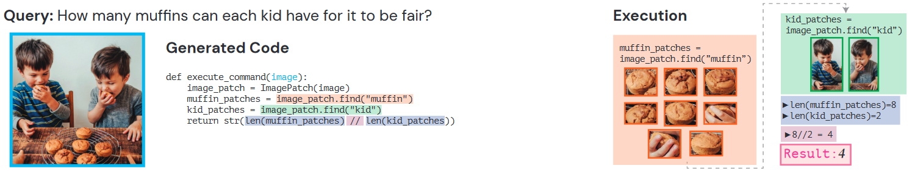
1）find
2) Count
3) reason

Slide 3
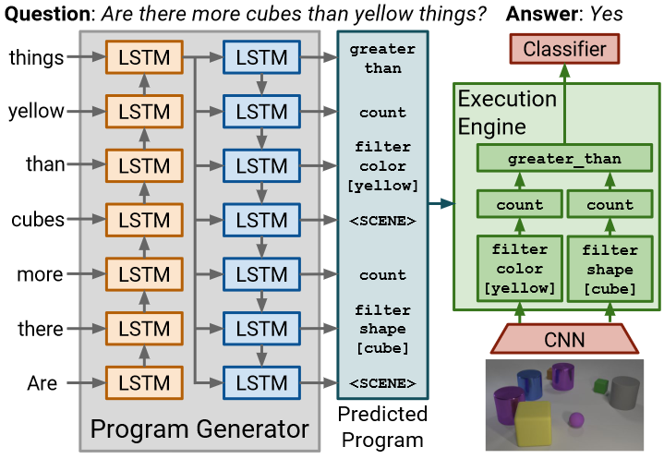
end-to-end models
Neural Module Networks
Inferring and Executing Programs for Visual Reasoning
uninterpretable
data and compute-hungry
difficult to extend to the real world
hand-tuned
domain-limited

Slide 4
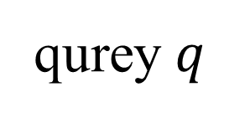
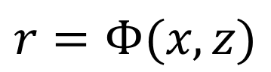
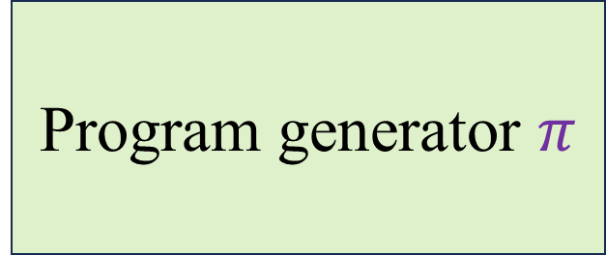
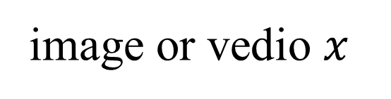
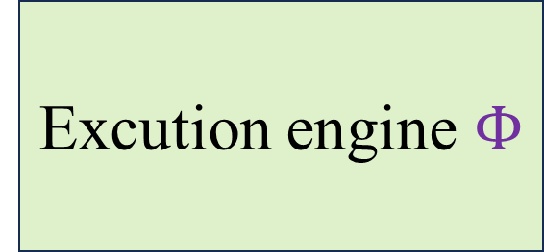
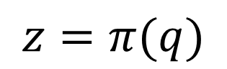
ViperGPT method
Program generator $π$
qurey $q$
$$z=π(q)$$
Codex
Excution engine $Φ$
image or vedio $x$
$$r=Φ(x,z)$$

Slide 5
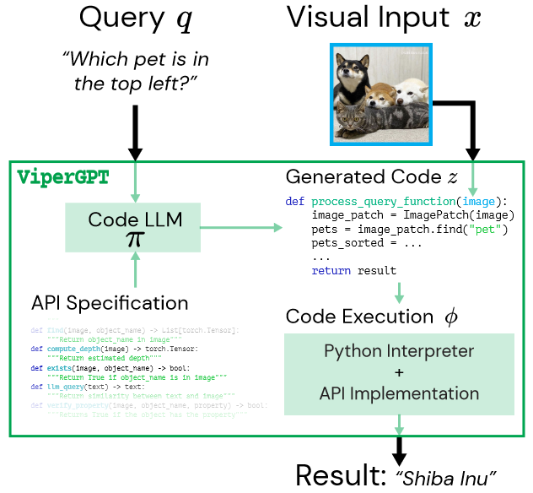
method
get_code(query)

Slide 6
APIs
find
GLIP
a list of image patches containing the noun phrase
image & short noun phrase
exists
GLIP
a boolean indicating whether an instance of that noun phrase is present in the image
image & short noun phrase
X-VLM
verify_
property
a boolean indicating whether the property is present in the image
image & short noun phrase
&attribute

Slide 7
APIs
X-VLM
best_image_match
a list of noun phrases
& one image
image patch that best matches the noun phrase
CLIP
best_text_match
a list of image patches
& short noun phrase
noun phrase that best matches the image
MiDaS
Compute
_depth
image
median depth
distance
built-in Python tools
image
the pixel-distance between two patches

Slide 8
example

Slide 9
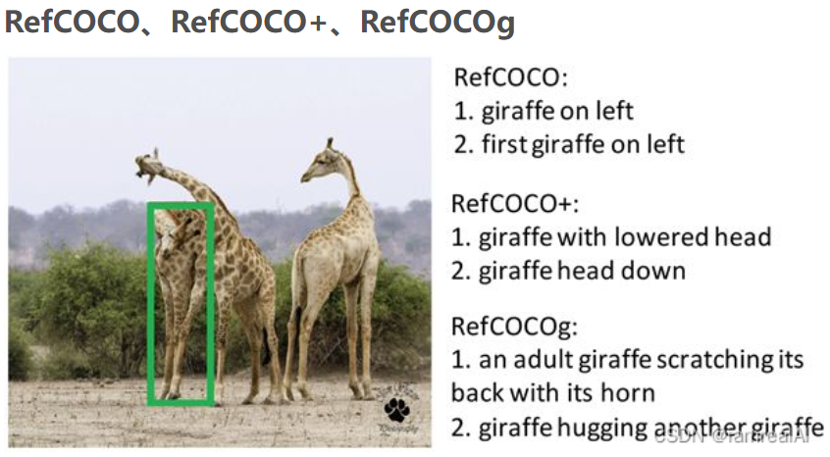
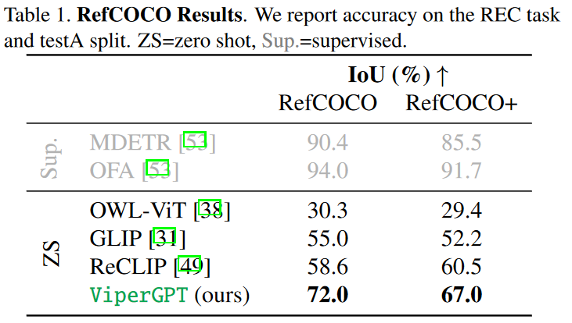
Evaluation
1) Visual Grounding
Dataset: RefCOCO, RefCOCO+

Slide 10
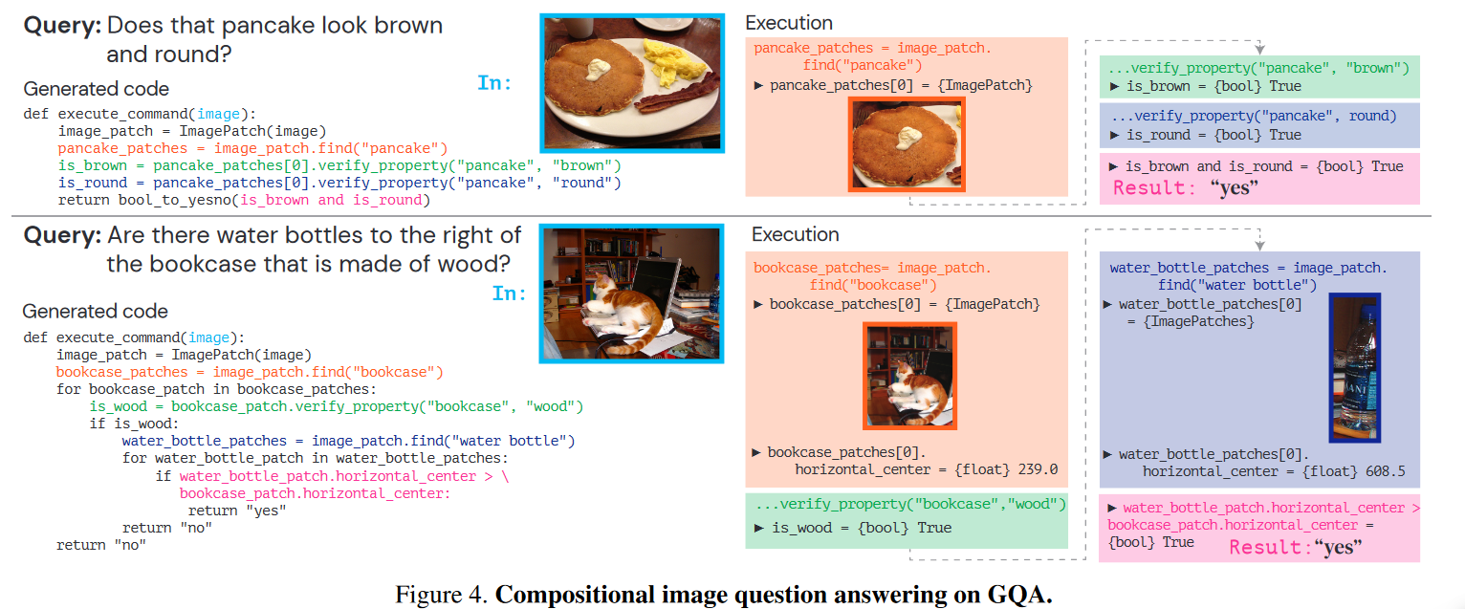
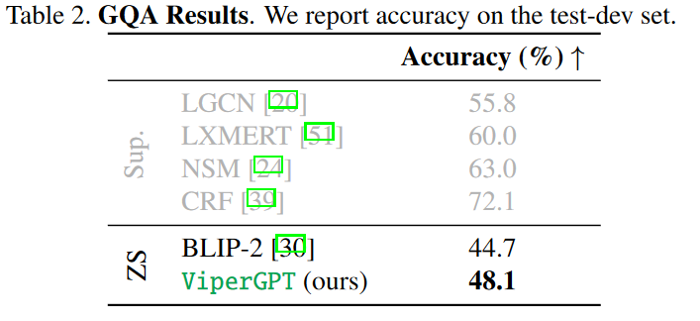
Evaluation
2) Compositional Image Question Answering
Dataset: GQA

Slide 11
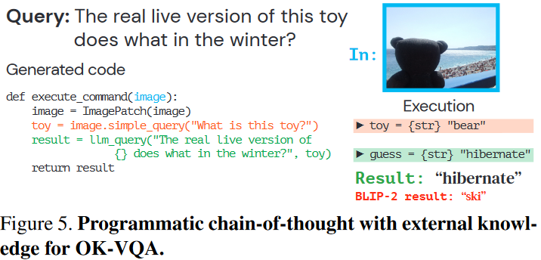
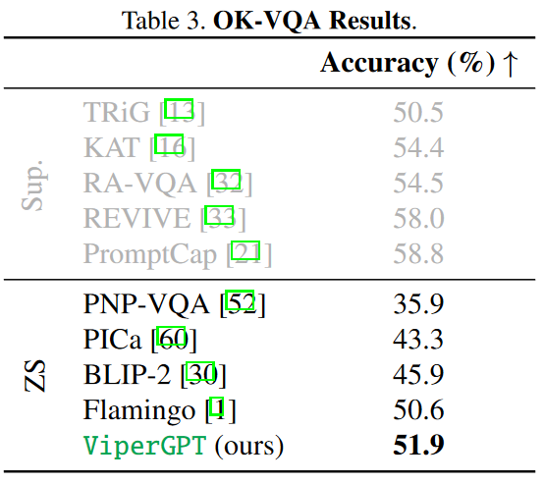
Evaluation
3) External Knowledge-dependent Image Question Answering
Dataset: OK-VQA

Slide 12
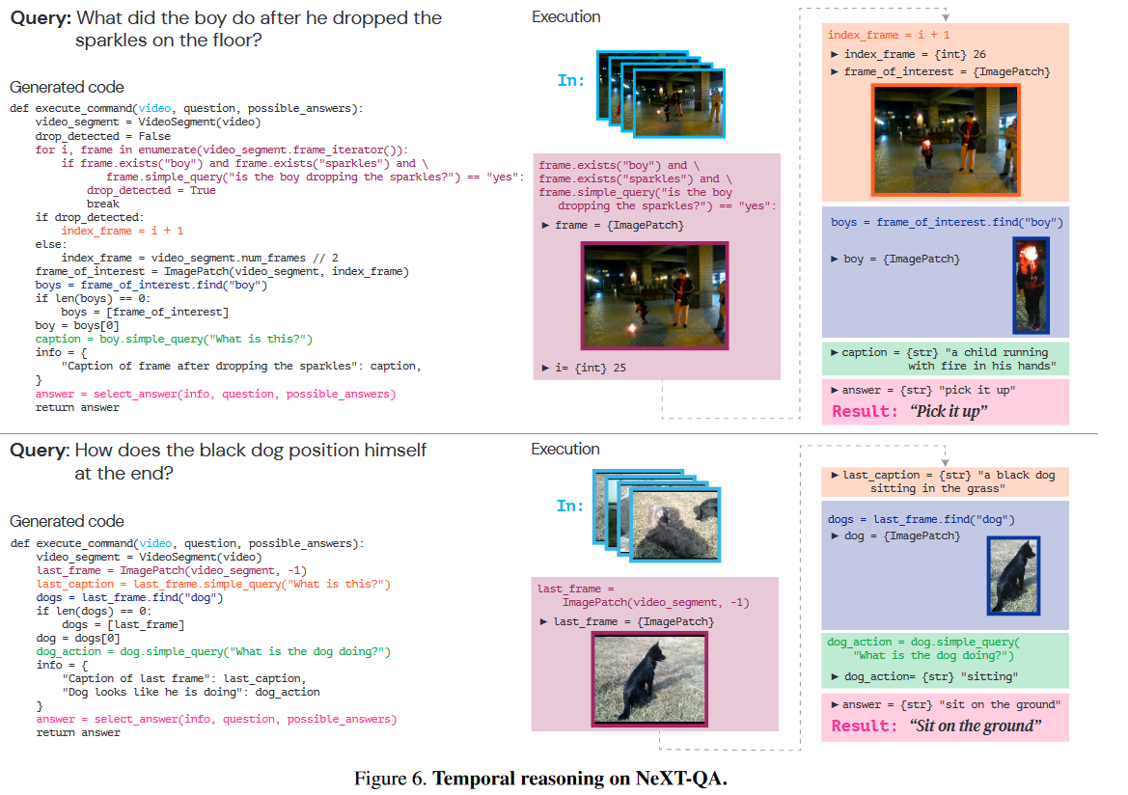
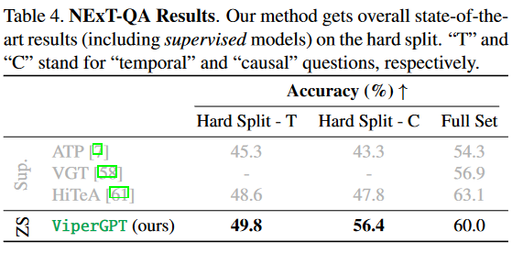
Evaluation
4) Video Causal/Temporal Reasoning
Dataset: NExT-QA

Slide 13
Conclusions
ViperGPT decomposes visual queries into interpretable steps
& generates code using LLMs

Slide 14
Benefits
Interpretable
logical
flexible
Compositional
adaptable
training-free
general

Slide 15


